Slide 1
FinAI North Macedonia Country Update

Slide 2
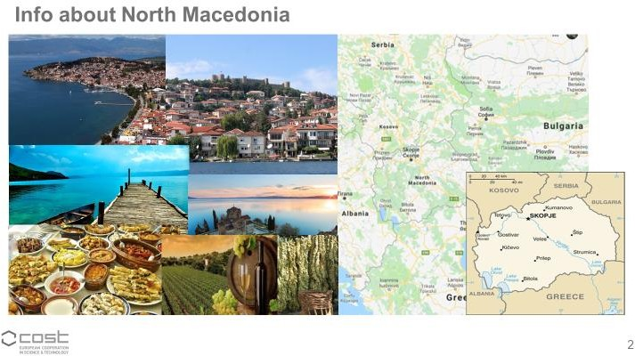

Slide 3
MK members
Prof. d-r Tatjana Atanasova Pachemska tatjana.pacemska@ugd.edu.mk
Prof. d-r Biljana Stojkoska biljana.stojkoska@finki.ukim.mk
Olivija Filiposka PhD, olivijaf@gmail.com
Dipl. Eng. Slave Temkov slave.temkov@finki.ukim.mk
Assoc. Prof. d-r Eftim Zdravevski eftim.zdravevski@finki.ukim.mk
Assist. Prof. d-r Petre Lameski petre.Lameski@finki.ukim.mk
Prof d-r Anastas Dzurovski anastas.dzurovski@uklo.edu.mk

Slide 4
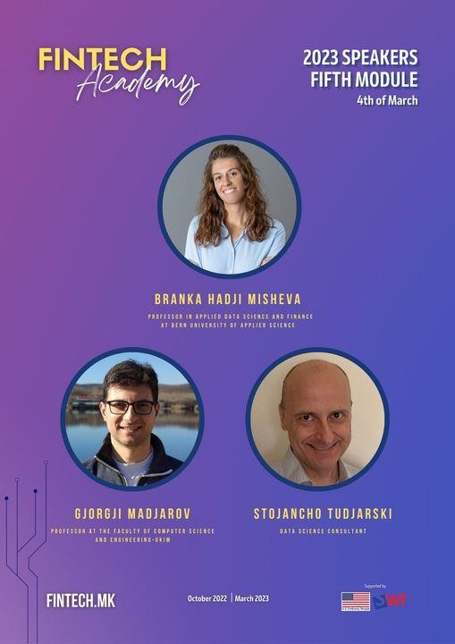
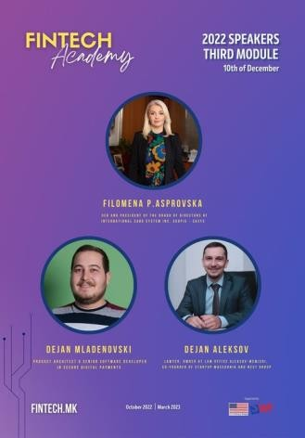
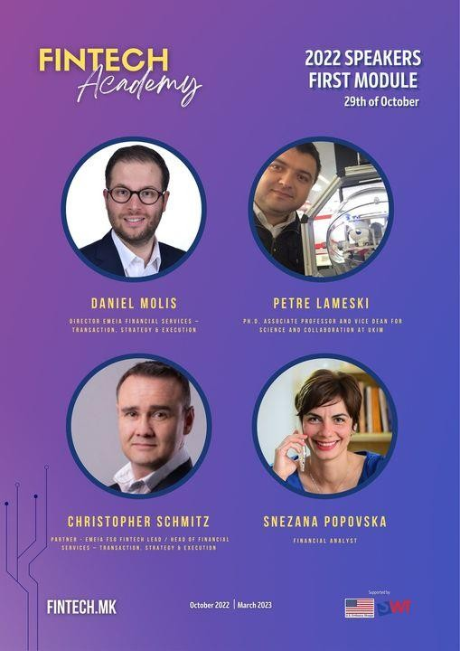

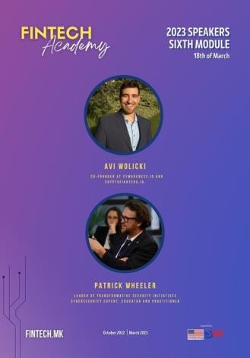
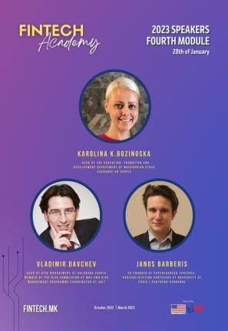
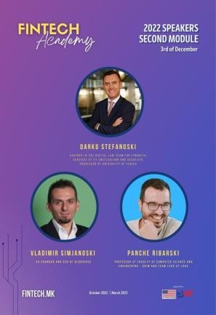
Fintech Academy

Slide 5
Joint action activity with other countries
4 publications
2 publications in review
2+ publications in preparation
2 online presentations
Direct involvement of MK WG members in deliverables
1 local meeting
4 local projects
2 project proposals

Slide 6
Industry and regulatory update
New law for interconnection of institutions including financial institutions (possible centralized data repo in the next 5-10 years)
Law on Payment Services and Payment Systems, drafted on PSD2 and PAD that will open the doors to Open Banking
OneID - electronic identity system for citizens accessing online services provided by companies and state institutions. It is developed and certified in accordance with EU standards, european regulations eIDAS
Regulatory Fintech Strategy – Proposed Actions for the Regulators

Slide 7
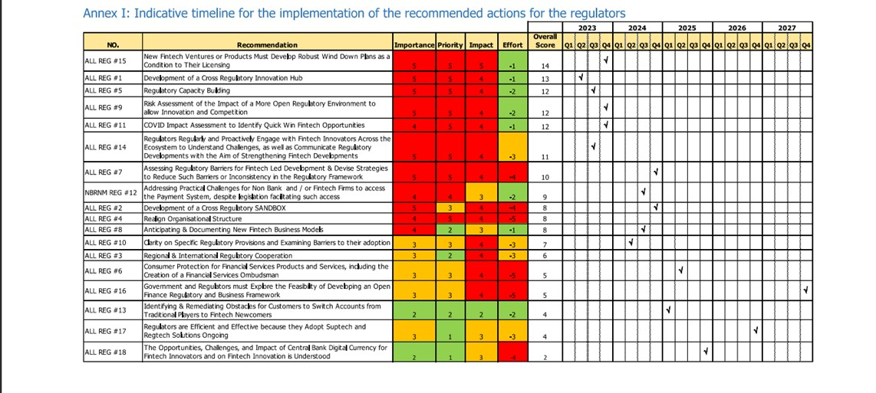

Slide 8
Updated activities GP4
active participation in networking events in Cluj Napoca, Brussels, Istanbul, Rethymno, Coimbra, Gran Canaria, Naples
organization and active participation in online workshops
collaborative activities referring to deliverables D7, D9, D15, D16
dissemination activities, developing new dissemination channel ResearchGate Lab
participation in new joint applications - COST, CIG application
developing partnerships with different stakeholders beyond our action
developing learning programs

